Slide 1
Cryptography (2021 Fall) mod, shift cipher, sufficient key space principle, substitution cipher, letter frequency analysis, Vigenère cipher, Kasiski’s method, index of coincidence
LiangFeng Zhang
zhanglf@shanghaitech.edu.cn
SIST, ShanghaiTech

Slide 2

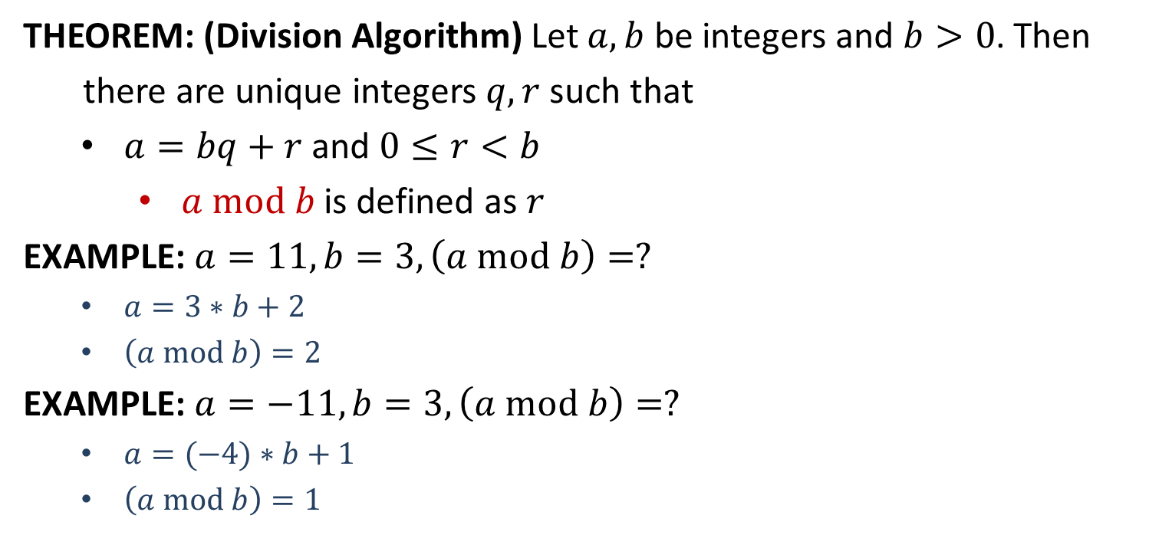
$$mod$$
THEOREM: (Division Algorithm) Let $a,b$ be integers and $b>0$. Then
there are unique integers $q,r$ such that
$a=bq+r$ and $0≤r<b$
$a mod b$ is defined as $r$
EXAMPLE: $a=11, b=3, \left(a mod b\right)=?$
$a=3∗b+2$
$\left(a mod b\right)=2$
EXAMPLE: $a=−11, b=3, \left(a mod b\right)=?$
$a=(−4)∗b+1$
$\left(a mod b\right)=1$

Slide 3



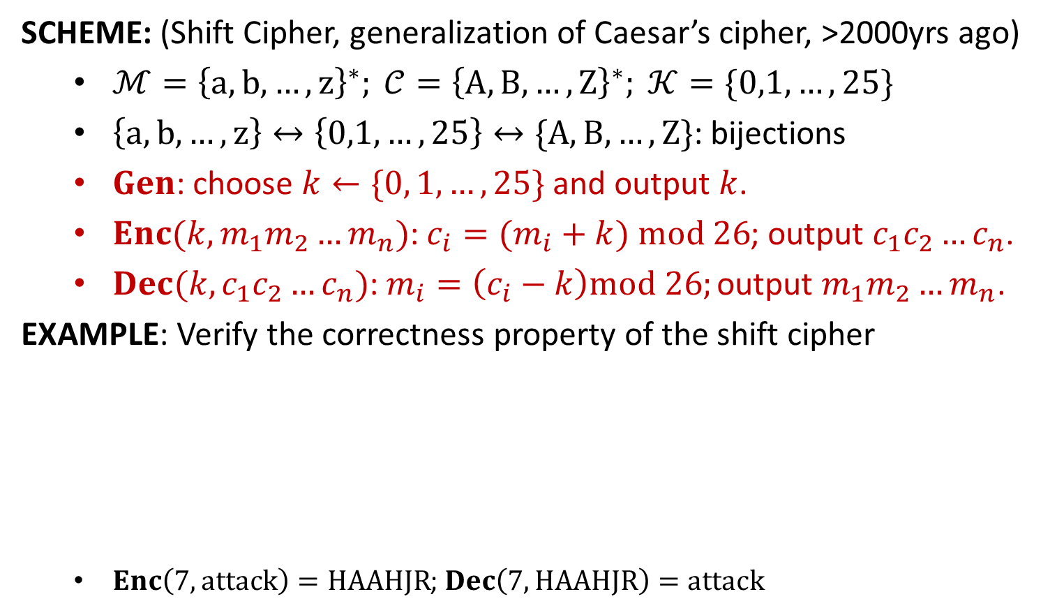












Shift Cipher
SCHEME: (Shift Cipher, generalization of Caesar’s cipher, >2000yrs ago)
$ℳ={\left\{a,b,…,z\right\}}^{∗}; 𝒞={\left\{A,B,…,Z\right\}}^{∗}; 𝒦=\{0,1,…,25\}$
$\left\{a,b,…,z\right\}↔\left\{0,1,…,25\right\}↔\{A,B,…,Z\}$: bijections
$Gen$: choose $k←\{0, 1,…, 25\}$ and output $k$.
$Enc(k,m_{1}m_{2}…m_{n})$: $c_{i}=(m_{i}+k) mod 26$; output $c_{1}c_{2}…c_{n}$.
$Dec(k,c_{1}c_{2}…c_{n})$: $m_{i}=\left(c_{i}−k\right)mod 26;$ output $m_{1}m_{2}…m_{n}$.
EXAMPLE: Verify the correctness property of the shift cipher
$Enc\left(7,attack\right)=HAAHJR$; $Dec\left(7, HAAHJR\right)=attack$
∙∙∙∙∙∙
$$x$$
$$y$$
$$z$$
$$a$$
$$b$$
$$c$$
∙∙∙∙∙∙
$$u$$
∙∙∙∙∙∙
∙∙∙∙∙∙
$$E$$
$$F$$
$$G$$
$$H$$
$$I$$
$$J$$
∙∙∙∙∙∙
$$B$$
∙∙∙∙∙∙
$$k=7$$

Slide 4

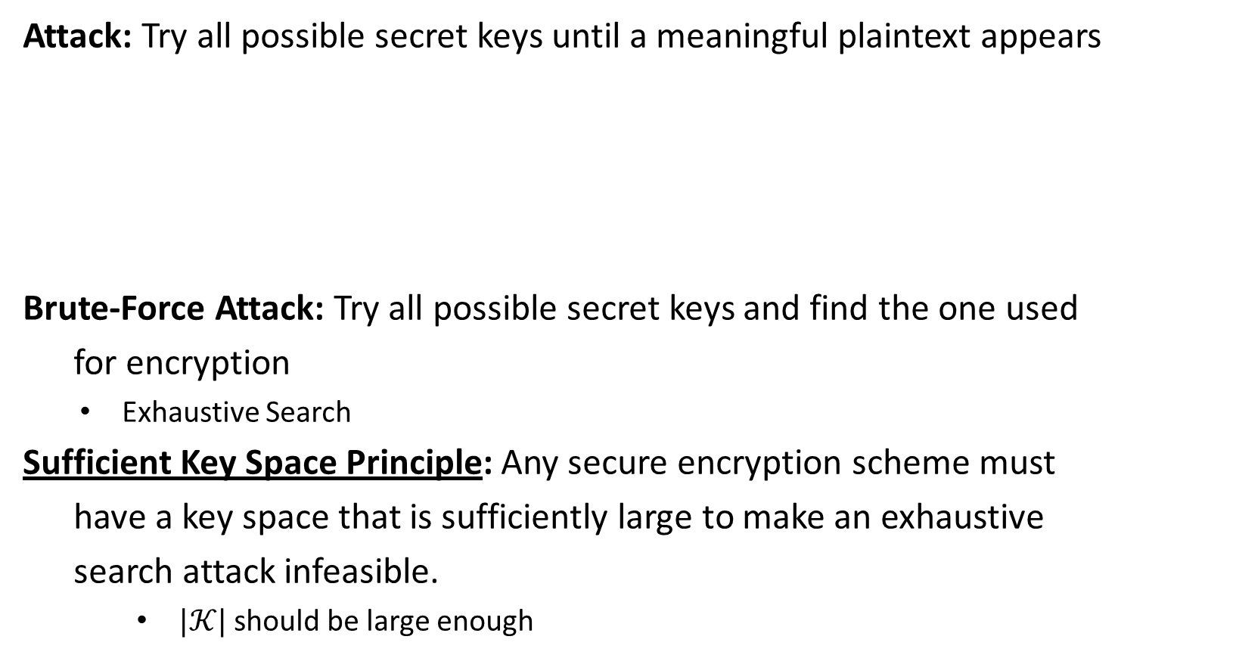







Security
Attack: Try all possible secret keys until a meaningful plaintext appears
Brute-Force Attack: Try all possible secret keys and find the one used
for encryption
Exhaustive Search
Sufficient Key Space Principle: Any secure encryption scheme must
have a key space that is sufficiently large to make an exhaustive
search attack infeasible.
$|𝒦|$ should be large enough
$Dec\left(0,HAAHJR\right)=haahjr$
$$Dec\left(4,HAAHJR\right)=dwwdfn$$
$Dec\left(1,HAAHJR\right)=gzzgiq$
$$Dec\left(5,HAAHJR\right)=cvvcem$$
$Dec\left(2,HAAHJR\right)=fyyfhp$
$$Dec\left(6,HAAHJR\right)=buubdl$$
$Dec\left(3,HAAHJR\right)=exxego$
$$Dec\left(7,HAAHJR\right)=attack$$

Slide 6
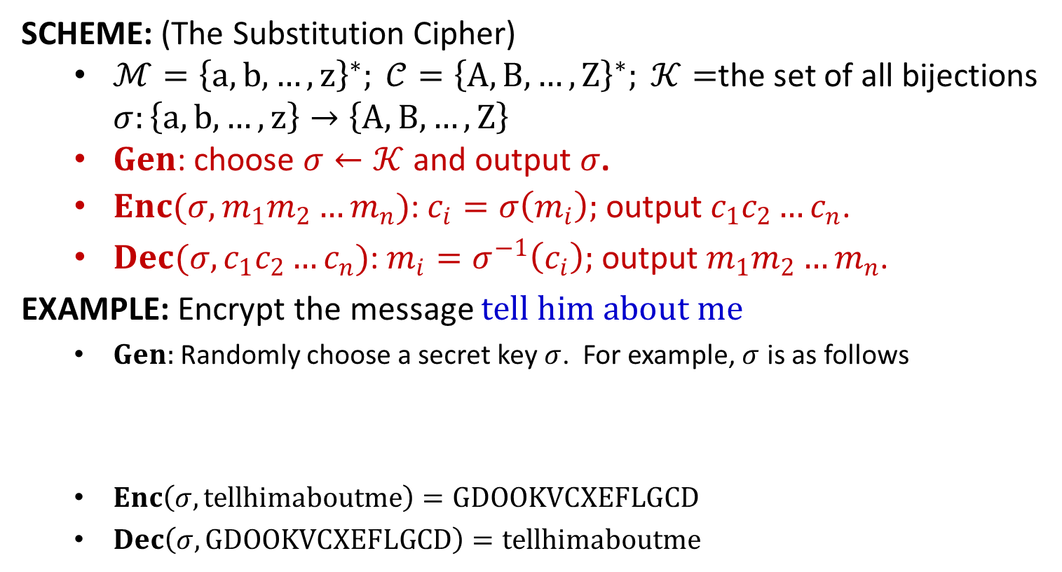
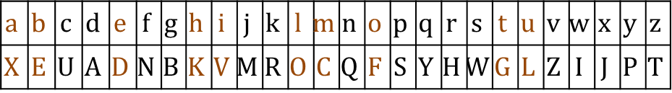
Substitution Cipher
SCHEME: (The Substitution Cipher)
$ℳ={\left\{a,b,…,z\right\}}^{∗}; 𝒞={\left\{A,B,…,Z\right\}}^{∗}; 𝒦=$the set of all bijections $σ:\left\{a,b,…,z\right\}→\left\{A,B,…,Z\right\}$
$Gen$: choose $σ←𝒦$ and output $σ$.
$Enc(σ,m_{1}m_{2}…m_{n})$: $c_{i}=σ\left(m_{i}\right);$ output $c_{1}c_{2}…c_{n}$.
$Dec(σ,c_{1}c_{2}…c_{n})$: $m_{i}=σ^{−1}\left(c_{i}\right);$ output $m_{1}m_{2}…m_{n}$.
EXAMPLE: Encrypt the message $tell him about me$
$Gen:$ Randomly choose a secret key $σ$. For example, $σ$ is as follows
$Enc\left(σ,tellhimaboutme\right)=GDOOKVCXEFLGCD$
$Dec\left(σ,GDOOKVCXEFLGCD\right)=tellhimaboutme$
$$a$$ | $$b$$ | $$c$$ | $$d$$ | $$e$$ | $$f$$ | $$g$$ | $$h$$ | $$i$$ | $$j$$ | $$k$$ | $$l$$ | $$m$$ | $$n$$ | $$o$$ | $$p$$ | $$q$$ | $$r$$ | $$s$$ | $$t$$ | $$u$$ | $$v$$ | $$w$$ | $$x$$ | $$y$$ | $$z$$
$$X$$ | $$E$$ | $$U$$ | $$A$$ | $$D$$ | $$N$$ | $$B$$ | $$K$$ | $$V$$ | $$M$$ | $$R$$ | $$O$$ | $$C$$ | $$Q$$ | $$F$$ | $$S$$ | $$Y$$ | $$H$$ | $$W$$ | $$G$$ | $$L$$ | $$Z$$ | $$I$$ | $$J$$ | $$P$$ | $$T$$

Slide 7
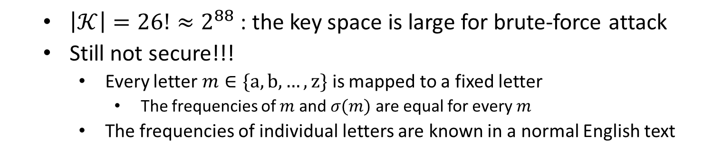
Security
$\left|𝒦\right|=26!≈2^{88}$ : the key space is large for brute-force attack
Still not secure!!!
Every letter $m∈\{a,b,…,z\}$ is mapped to a fixed letter
The frequencies of $m$ and $σ(m)$ are equal for every $m$
The frequencies of individual letters are known in a normal English text

Slide 8
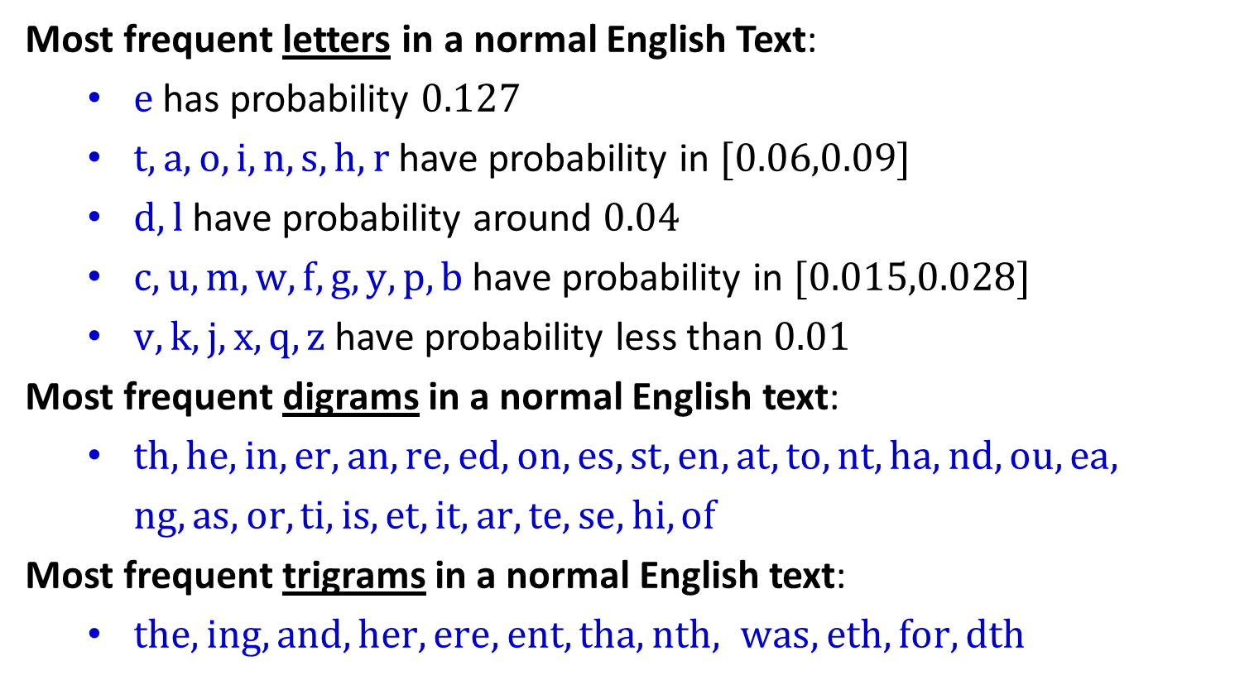
Letter Frequency Analysis
Most frequent letters in a normal English Text:
$e$ has probability $0.127$
$t,a,o,i,n,s,h,r$ have probability in $[0.06,0.09]$
$d,l$ have probability around $0.04$
$c,u,m,w,f,g,y,p,b$ have probability in $[0.015,0.028]$
$v,k,j,x,q,z$ have probability less than $0.01$
Most frequent digrams in a normal English text:
$th,he,in,er, an, re, ed,on, es, st, en,at, to,nt, ha, nd, ou, ea,$
$ng, as, or, ti, is, et, it, ar, te, se, hi, of$
Most frequent trigrams in a normal English text:
$the, ing,and, her, ere, ent, tha, nth, was, eth, for, dth$
√
√

Slide 9
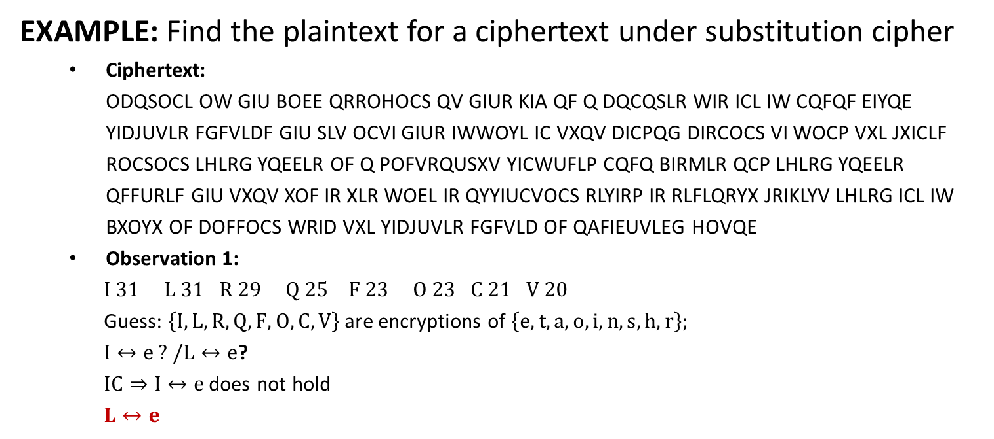
Example
EXAMPLE: Find the plaintext for a ciphertext under substitution cipher
Ciphertext: ODQSOCL OW GIU BOEE QRROHOCS QV GIUR KIA QF Q DQCQSLR WIR ICL IW CQFQF EIYQE YIDJUVLR FGFVLDF GIU SLV OCVI GIUR IWWOYL IC VXQV DICPQG DIRCOCS VI WOCP VXL JXICLF ROCSOCS LHLRG YQEELR OF Q POFVRQUSXV YICWUFLP CQFQ BIRMLR QCP LHLRG YQEELR QFFURLF GIU VXQV XOF IR XLR WOEL IR QYYIUCVOCS RLYIRP IR RLFLQRYX JRIKLYV LHLRG ICL IW BXOYX OF DOFFOCS WRID VXL YIDJUVLR FGFVLD OF QAFIEUVLEG HOVQE
Observation 1:
$I 31 L 31 R 29 Q 25 F 23 O 23 C 21 V 20$
Guess: $\left\{I,L,R,Q,F,O,C,V\right\}$ are encryptions of $\left\{e,t,a,o,i,n,s,h,r\right\};$
$I↔e ? /L↔e$?
$IC⇒I↔e$ does not hold
$L↔e$

Slide 10
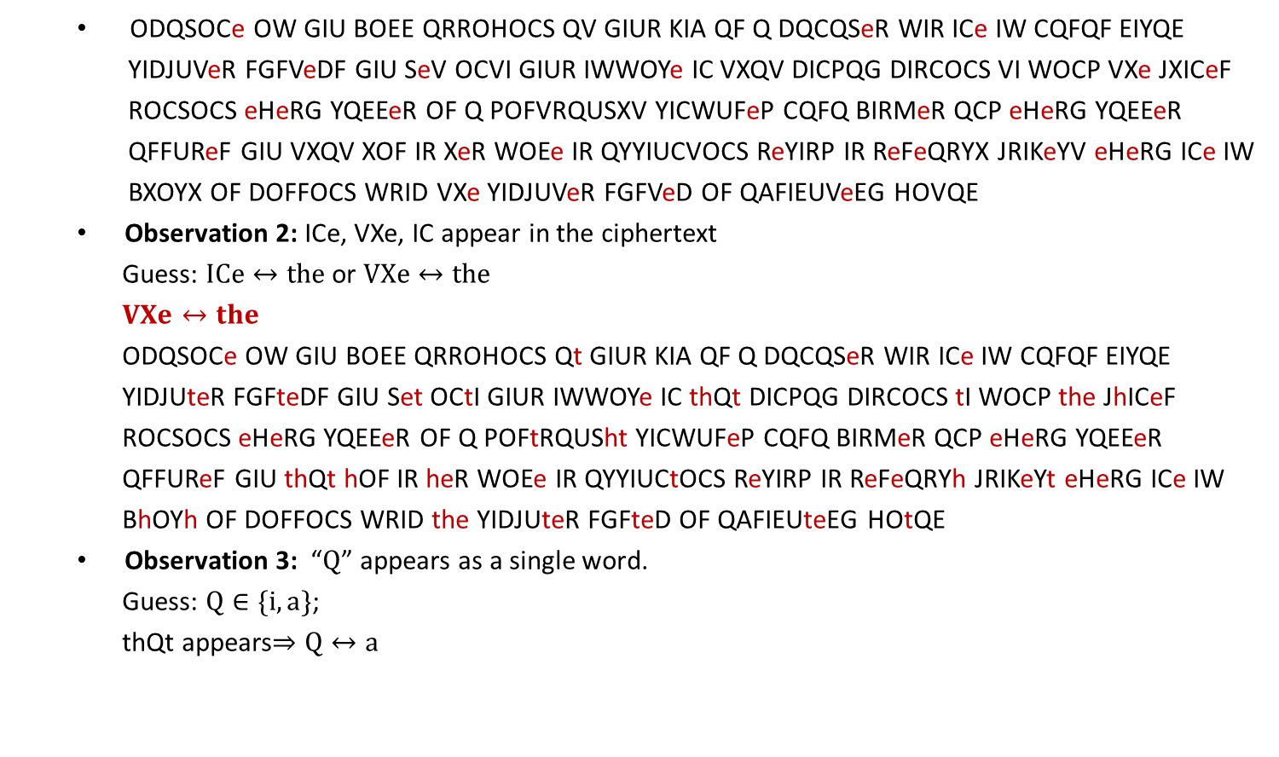
Example
ODQSOCe OW GIU BOEE QRROHOCS QV GIUR KIA QF Q DQCQSeR WIR ICe IW CQFQF EIYQE
YIDJUVeR FGFVeDF GIU SeV OCVI GIUR IWWOYe IC VXQV DICPQG DIRCOCS VI WOCP VXe JXICeF
ROCSOCS eHeRG YQEEeR OF Q POFVRQUSXV YICWUFeP CQFQ BIRMeR QCP eHeRG YQEEeR
QFFUReF GIU VXQV XOF IR XeR WOEe IR QYYIUCVOCS ReYIRP IR ReFeQRYX JRIKeYV eHeRG ICe IW
BXOYX OF DOFFOCS WRID VXe YIDJUVeR FGFVeD OF QAFIEUVeEG HOVQE
Observation 2: ICe, VXe, IC appear in the ciphertext
Guess: $ICe↔the$ or $VXe↔the$
$VXe↔the$
ODQSOCe OW GIU BOEE QRROHOCS Qt GIUR KIA QF Q DQCQSeR WIR ICe IW CQFQF EIYQE
YIDJUteR FGFteDF GIU Set OCtI GIUR IWWOYe IC thQt DICPQG DIRCOCS tI WOCP the JhICeF
ROCSOCS eHeRG YQEEeR OF Q POFtRQUSht YICWUFeP CQFQ BIRMeR QCP eHeRG YQEEeR
QFFUReF GIU thQt hOF IR heR WOEe IR QYYIUCtOCS ReYIRP IR ReFeQRYh JRIKeYt eHeRG ICe IW
BhOYh OF DOFFOCS WRID the YIDJUteR FGFteD OF QAFIEUteEG HOtQE
Observation 3: “$Q$” appears as a single word.
Guess: $Q∈\{i,a\}$;
thQt appears$⇒Q↔a$

Slide 11
Example
ODaSOCe OW GIU BOEE aRROHOCS at GIUR KIA aF a DaCaSeR WIR ICe IW CaFaF EIYaE YIDJUteR FGFteDF GIU Set OCtI GIUR IWWOYe IC that DICPaG DIRCOCS tI WOCP the JhICeF ROCSOCS eHeRG YaEEeR OF a POFtRaUSht YICWUFeP CaFa BIRMeR aCP eHeRG YaEEeR aFFUReF GIU that hOF IR heR WOEe IR aYYIUCtOCS ReYIRP IR ReFeaRYh JRIKeYt eHeRG ICe IW BhOYh OF DOFFOCS WRID the YIDJUteR FGFteD OF aAFIEUteEG HOtaE
Plaintext:
imagine if you will arriving at your job as a manager for one of NASAs local computer systems you
get into your office on that Monday morning to find the phones ringing every caller is a distraught
confused NASA worker and every caller assures you that his or her file or accounting record or
research project every one of which is missing from the computer system is absolutely vital
Imagine, if you will, arriving at your job as a manager for one of NASAs local computer systems. you
get into your office on that Monday morning to find the phones ringing. every caller is a distraught,
confused NASA worker. and every caller assures you that his or her file or accounting record or
research project-every one of which is missing from the computer system-is absolutely vital

Slide 12
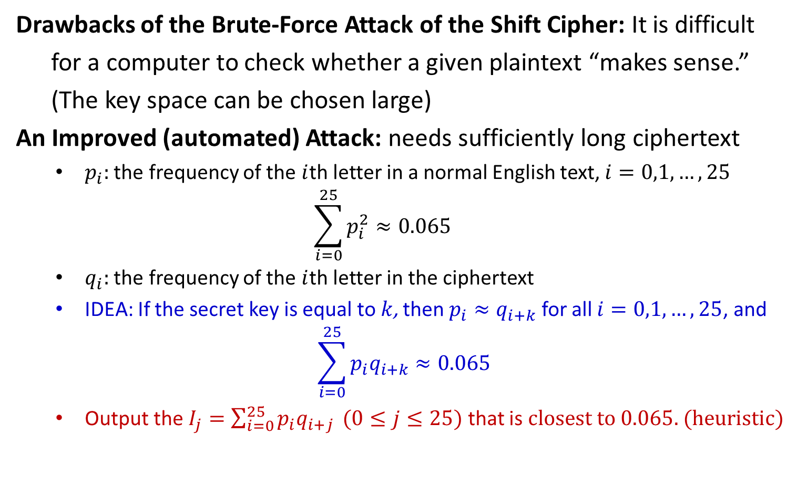
Improved Attack of the Shift Cipher
Drawbacks of the Brute-Force Attack of the Shift Cipher: It is difficult
for a computer to check whether a given plaintext “makes sense.”
(The key space can be chosen large)
An Improved (automated) Attack: needs sufficiently long ciphertext
$p_{i}:$ the frequency of the $i$th letter in a normal English text, $i=0,1,…,25$
$$\sum_{i=0}^{25}{p_{i}^{2}}≈0.065$$
$q_{i}:$ the frequency of the $i$th letter in the ciphertext
IDEA: If the secret key is equal to $k$, then $p_{i}≈q_{i+k}$ for all $i=0,1,…,25$, and
$$\sum_{i=0}^{25}{p_{i}q_{i+k}}≈0.065$$
Output the $I_{j}=\sum_{i=0}^{25}{p_{i}q_{i+j}} (0≤j≤25)$ that is $closest to 0.065$. (heuristic)

Slide 14
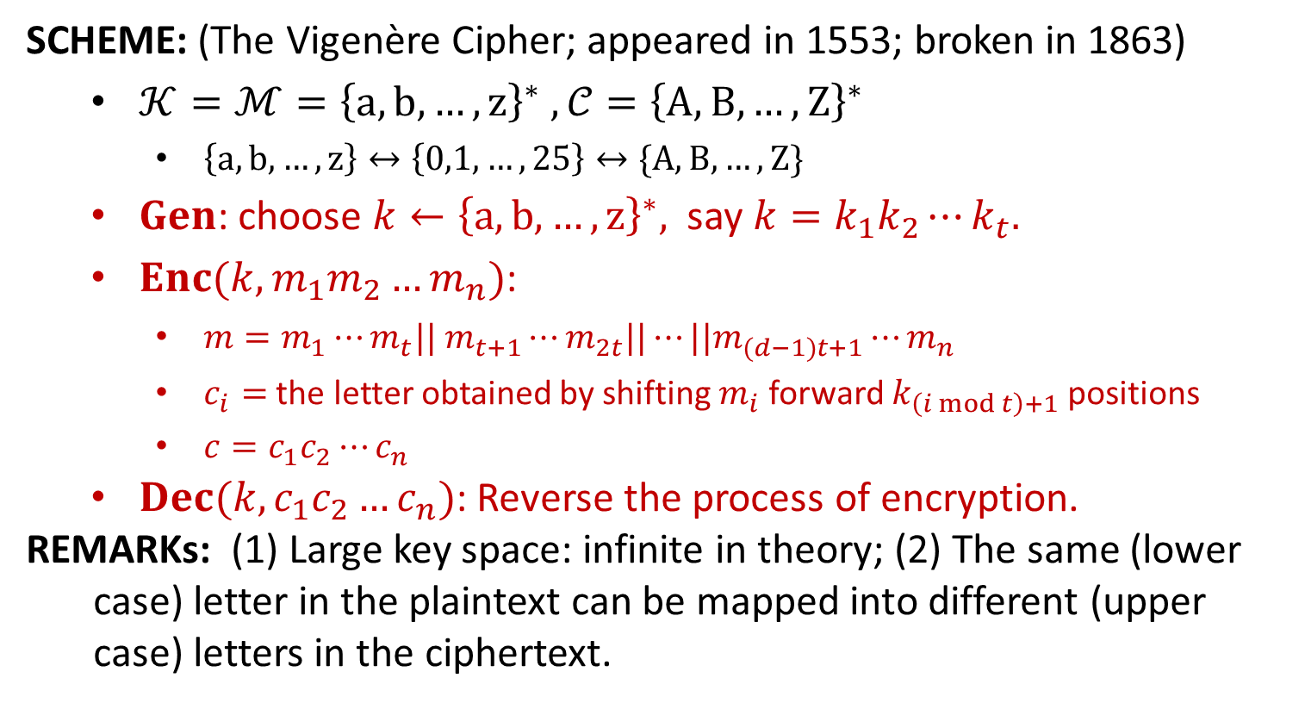
Vigenère Cipher
SCHEME: (The Vigenère Cipher; appeared in 1553; broken in 1863)
$𝒦=ℳ={\left\{a, b,…, z\right\}}^{∗} , 𝒞={\left\{A,B,…,Z\right\}}^{∗}$
$\left\{a, b,…, z\right\}↔\left\{0,1,…,25\right\}↔\{A,B,…,Z\}$
$Gen$: choose $k←{\left\{a,b,…,z\right\}}^{∗},$ say $k=k_{1}k_{2}⋯k_{t}.$
$Enc(k,m_{1}m_{2}…m_{n})$:
$m=m_{1}⋯m_{t}|| m_{t+1}⋯m_{2t}||⋯||m_{(d−1)t+1}⋯m_{n}$
$c_{i}=$ the letter obtained by shifting $m_{i}$ forward $k_{\left(i mod t\right)+1}$ positions
$c=c_{1}c_{2}⋯c_{n}$
$Dec(k,c_{1}c_{2}…c_{n})$: Reverse the process of encryption.
REMARKs: (1) Large key space: infinite in theory; (2) The same (lower
case) letter in the plaintext can be mapped into different (upper
case) letters in the ciphertext.
Still not secure!!!

Slide 15
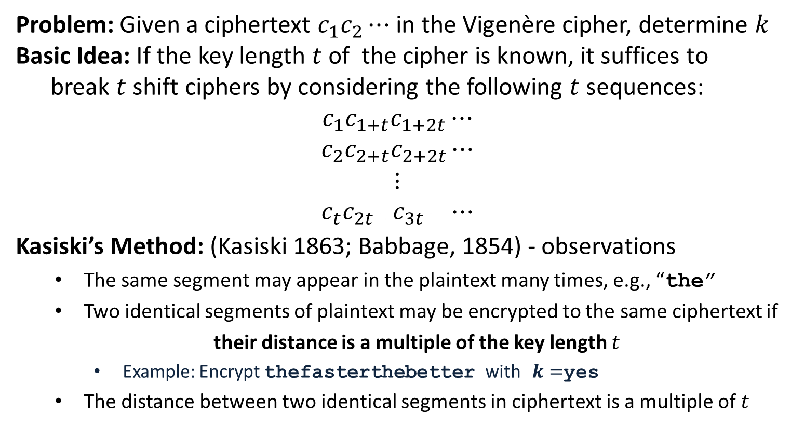
Attacks
Problem: Given a ciphertext $c_{1}c_{2}⋯$ in the Vigenère cipher, determine $k$
Basic Idea: If the key length $t$ of the cipher is known, it suffices to
break $t$ shift ciphers by considering the following $t$ sequences:
$$c_{1}c_{1+t}c_{1+2t}⋯$$
$$c_{2}c_{2+t}c_{2+2t}⋯$$
$$⋮$$
$$c_{t}c_{2t+ }c_{3t+ }⋯$$
Kasiski’s Method: (Kasiski 1863; Babbage, 1854) - observations
The same segment may appear in the plaintext many times, e.g., “the”
Two identical segments of plaintext may be encrypted to the same ciphertext if
their distance is a multiple of the key length $t$
Example: Encrypt thefasterthebetter with $k=$yes
The distance between two identical segments in ciphertext is a multiple of $t$

Slide 16
Attacks
Kasiski’s Method: (Kasiski 1863; Babbage, 1854) - algorithm
Search the ciphertext for pairs of identical segments of length at least three;
Record the distances between the starting positions of any two segments;
Output the greatest common divisor of these distances.
EXAMPLE: Determine the key length for the following ciphertext.
CHREEVOAHMAERATBIAXXWTNXBEEOPHBSBQMQEQERBW
RVXUOAKXAOSXXWEAHBWGJMMQMNKGRFVGXWTRZXWIAK
LXFPSKAUTEMNDCMGTSXMXBTUIADNGMGPSRELXNJELX
VRVPRTULHDNQWTWDTYGBPHXTFALJHASVBFXNGLLCHR
ZBWELEKMSJIKNBHWRJGNMGJSGLXFEYPHAGNRBIEQJT
AMRVLCRREMNDGLXRRIMGNSNRWCHRQHAEYEVTAQEBBI
PEEWEVKAKOEWADREMXMTBHHCHRTKDNVRZCHRCLQOHP
WQAIIWXNRMGWOIIFKEE
CHR appear 5 times.
Locations: 1,166, 236, 276, 286.
Distances 165, 235, 275, 285
GCD is 5
Guess: key length is 5

Slide 17
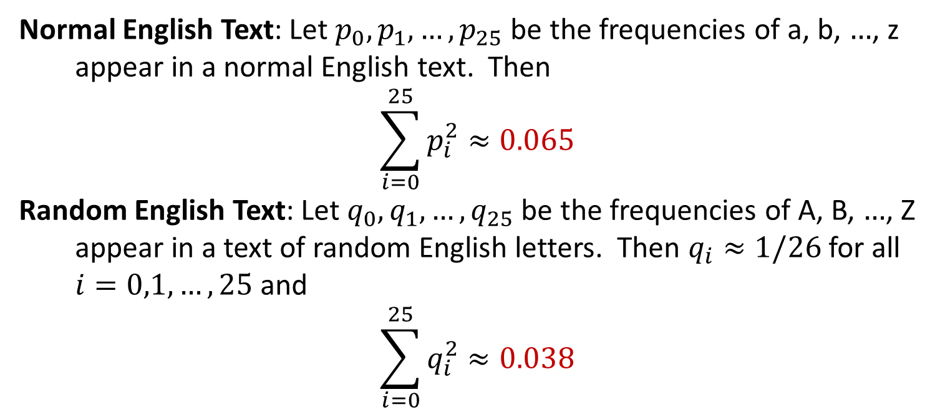
Attacks
Normal English Text: Let $p_{0},p_{1},…,p_{25}$ be the frequencies of a, b, $…$, z
appear in a normal English text. Then
$$\sum_{i=0}^{25}{p_{i}^{2}}≈0.065$$
Random English Text: Let $q_{0},q_{1},…,q_{25}$ be the frequencies of A, B, $…$, Z
appear in a text of random English letters. Then $q_{i}≈1/26$ for all
$i=0,1,…,25$ and
$$\sum_{i=0}^{25}{q_{i}^{2}≈0.038}$$

Slide 18
Attacks
Index of Coincidence: (Friedman, 1920) –algorithm
For $τ=1,2,…:$ split the ciphertext $c_{1}c_{2}⋯$ as
$${c_{1}=c}_{1}c_{1+τ}c_{1+2τ}⋯$$
$${c_{2}=c}_{2}c_{2+τ}c_{2+2τ}⋯$$
$$⋮$$
$${c_{τ}=c}_{τ}c_{2τ+ }c_{3τ+ }⋯$$
If $τ=t$, then each of $c_{1},c_{2},…,c_{τ}$ is encrypted using the same letter and thus $\sum_{i=0}^{25}{q_{i}^{2}≈0.065}$ in all of$c_{1},c_{2},…,c_{τ}$.
If $τ≠t$, then each of $c_{1},c_{2},…,c_{τ}$ is encrypted using different letters and thus $\sum_{i=0}^{25}{q_{i}^{2}≈0.038}$ in all of$c_{1},c_{2},…,c_{τ}$.
Output the $τ$ such that $\sum_{i=0}^{25}{q_{i}^{2}≈0.065}$ in all of $c_{1},c_{2},…,c_{τ}$.

Slide 19
Attacks
EXAMPLE: Determine the key length for the following ciphertext.
CHREEVOAHMAERATBIAXXWTNXBEEOPHBSBQMQEQERBW
RVXUOAKXAOSXXWEAHBWGJMMQMNKGRFVGXWTRZXWIAK
LXFPSKAUTEMNDCMGTSXMXBTUIADNGMGPSRELXNJELX
VRVPRTULHDNQWTWDTYGBPHXTFALJHASVBFXNGLLCHR
ZBWELEKMSJIKNBHWRJGNMGJSGLXFEYPHAGNRBIEQJT
AMRVLCRREMNDGLXRRIMGNSNRWCHRQHAEYEVTAQEBBI
PEEWEVKAKOEWADREMXMTBHHCHRTKDNVRZCHRCLQOHP
WQAIIWXNRMGWOIIFKEE
$τ=1:\sum_{i=0}^{25}{q_{i}^{2}}≈0.045$
$τ=2:\sum_{i=0}^{25}{q_{i}^{2}}≈0.046, 0.041$
$τ=3:\sum_{i=0}^{25}{q_{i}^{2}}≈0.043, 0.050, 0.047$
$τ=4:\sum_{i=0}^{25}{q_{i}^{2}}≈0.042, 0.039, 0.045, 0.040$
$τ=5:\sum_{i=0}^{25}{q_{i}^{2}}≈0.063, 0.068, 0.069, 0.061, 0.072$
When $τ=5$, all numbers are close to 0.065; $t$ could be 5!

Slide 20
Attacks
Problem: Given a ciphertext ${c=c}_{1}c_{2}⋯$ in the Vigenère cipher,
and the key length $t$, determine the key $k$.
Basic Idea: Split the ciphertext into $t$ subsequences:
$${c_{1}=c}_{1}c_{1+t}c_{1+2t}⋯$$
$${c_{2}=c}_{2}c_{2+t}c_{2+2t}⋯$$
$$⋮$$
$${c_{t}=c}_{t}c_{2t} c_{3t }⋯$$
$c_{1}$ is a shift cipher with key $k_{1}∈\{0,1,…,25\}$
Let $q_{0},q_{1},…,q_{25}$ be the frequencies of A, B, …, Z in $c_{1}$
$q_{i+k_{1}}≈p_{i}$ for all $i∈\{0,1,…,25\}$
$$\sum_{i=0}^{25}{p_{i}q_{i+k_{1}}}≈\sum_{i=0}^{25}{p_{i}^{2}}≈0.065.$$

Slide 21
Determine the Key
EXAMPLE: Determine the plaintext for the following ciphertext.
CHREEVOAHMAERATBIAXXWTNXBEEOPHBSBQMQEQERBW
RVXUOAKXAOSXXWEAHBWGJMMQMNKGRFVGXWTRZXWIAK
LXFPSKAUTEMNDCMGTSXMXBTUIADNGMGPSRELXNJELX
VRVPRTULHDNQWTWDTYGBPHXTFALJHASVBFXNGLLCHR
ZBWELEKMSJIKNBHWRJGNMGJSGLXFEYPHAGNRBIEQJT
AMRVLCRREMNDGLXRRIMGNSNRWCHRQHAEYEVTAQEBBI
PEEWEVKAKOEWADREMXMTBHHCHRTKDNVRZCHRCLQOHP
WQAIIWXNRMGWOIIFKEE
We guess the key length is 5. Split the ciphertext into 5 sequences:
CVABWEBQBUAWWQRWWXANTBDPXXRDWBFAXCWMNJJFAIACNRNCATBWKDMCDCQQXWK
HOEITESEWOOEGMFTIFUDSTNSNVTNDPASNHESBGSEGEMRDRSHEAIEORTHNHOANOE
RARANOBQRASAJNVRAPTCXUGRJRUQTHLVGRLJHNGYNQRRGINRYQPVEEBRVRHIRIE
EHAXXPQEVKXHMKGZKSEMMIMEEVLWYXJBLZEIWMLPRJVELMRQEEEKWMHTRCPIMI
EMTXBHMRXXXBMGXXLKMGXAGLLPHTGTHFLBKKRGXHBTLMXGWHVBEAAXHKZLWWGF

Slide 22
Determine the Key
$$i$$ | Value of $\sum_{i=0}^{25}{p_{i}q_{i+k}}$
1 | .035 .061 .042 | .031 .039 .043 | .036 .032 .037 | .037 .040 .033 | .035 .039 .049 | .039 .038 .043 | .028 .045 .042 | .028 .036 .036 | .048 .030
2 | .068 .031 .034 | .044 .042 .038 | .032 .045 .032 | .035 .040 .034 | .044 .045 .043 | .034 .046 .032 | .036 .042 .026 | .033 .037 .047 | .029 .032
3 | .048 .049 .027 | .029 .035 .035 | .042 .031 .034 | .043 .035 .034 | .044 .065 .037 | .034 .036 .035 | .038 .038 .046 | .035 .036 .040 | .032 .044
4 | .045 .049 .037 | .032 .033 .050 | .033 .042 .034 | .038 .040 .034 | .060 .033 .039 | .034 .029 .043 | .034 .036 .038 | .034 .041 .035 | .050 .044
5 | .034 .037 .044 | .031 .033 .072 | .035 .032 .037 | .044 .036 .027 | .047 .037 .031 | .037 .036 .048 | .042 .045 .036 | .039 .032 .037 | .042 .029
$K=\left(9,0,13,4,19\right)=$JANET

